Slide 1
Elements of Graph Theory
Chapter 5

Slide 2
5.1. Definitions and Examples
Undirected graph
Directed graph
loop
G=(V,E)
isolated vertex
multiple
edges
Adjacent :- two vertices are said to be adjacent if there is an edge between them.
A vertex is pendant if and only if it has degree o ne.
A vertex of degree zero is called isolated.

Slide 3
General Types of Graph
Undirected Graph
Definition:- A graph G = (V , E) consists of V , a nonempty set of vertices (or nodes) and E, a set of edges. Each edge has either one or two vertices associated with it, called its endpoints. An edge is said to connect its endpoints.
2. Directed Graph
Definition:- A directed graph (or digraph) (V , E) consists of a nonempty set of vertices V and a set of directed edges (or arcs) E. Each directed edge is associated with an ordered pair of vertices.
The directed edge associated with the ordered pair (u, v) is said to start at u and end at v.
3. Weighted Graph
Definition:- A weighted graph has values (weights or a real number) assigned to its edges.
4. Mixed Graph
Definition:- A graph with both directed and undirected edges is called a mixed graph.

Slide 4
Types of Undirected Graph
Simple Graph
A graph in which each edge connects two different vertices and where no two edges connect the same pair of vertices is called a simple graph.
An edge that connect a vertex to itself such edges are called loops
In otherword, A graph without loops and multiple edges.
2. Multi Graph
Graphs that may have multiple edges connecting the same vertices are called multigraphs.
3. Pseudo Graph
Graphs that may include loops, and possibly multiple edges connecting the same pair of vertices or a vertex to itself, are sometimes called pseudographs

Slide 5
5.2. Types of Simple Graphs
Empty Graph(En) is a graph without edges.
Cycle Graph(Cn)
Wheel Graph(Wn)
Complete Graph(Kn)
Regular Graph(Rn)
Bipartite Graph
Complete Bipartite Graph (Kn,m)
N-cube Graph(Qn)

Slide 6
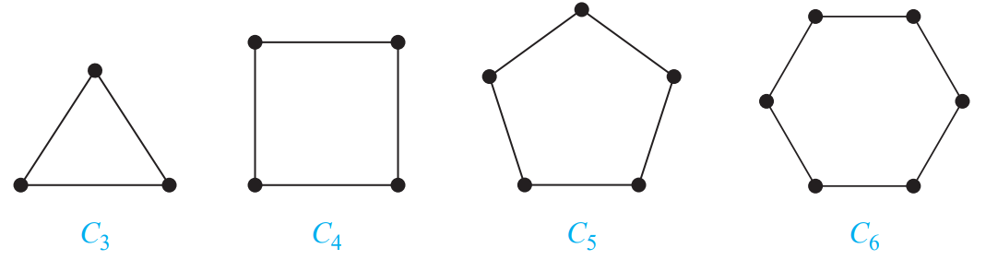
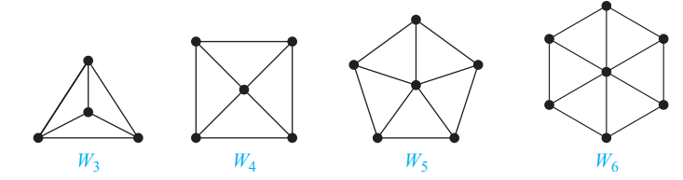
Continued…
2. Cycle:-
A cycle Cn, n ≥ 3, consists of n vertices v1, v2,..., vn and edges {v1, v2}, {v2, v3},...,{vn−1, vn}, and {vn, v1}. The cycles C3, C4, C5, and C6 are displayed in Figure below
3. Wheels:- We obtain a wheel Wn when we add an additional vertex to a cycle Cn, for n ≥ 3, and connect this new vertex to each of the n vertices in Cn, by new edges. The wheels W3, W4, W5, and W6 are displayed in Figure

Slide 7
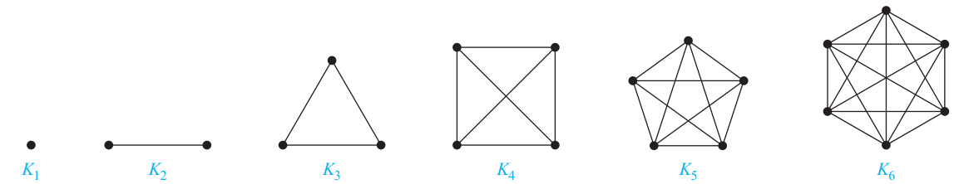
Continued…
4. Complete Graphs:- A complete graph on n vertices, denoted by Kn, is a simple graph that contains exactly one edge between each pair of distinct vertices.
5. Regular Graph(Rn):- A regular graph: each vertex has the same degree.
Example:- Is it possible to have a 4-regular graph with 10 edges?
2|E|=4|V|=20, |V|=5 possible (K₅)
with 15 edges?
2|E|=4|V|=30 not possible

Slide 8
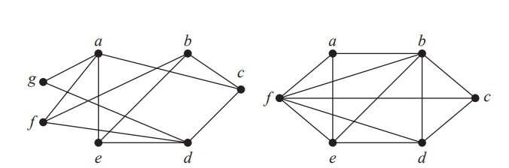
Continued…
6. Bipartite Graph
A simple graph G is called bipartite if its vertex set V can be partitioned into two disjoint sets V1 and V2 such that every edge in the graph connects a vertex in V1 and a vertex in V2 (so that no edge in G connects either two vertices in V1 or two vertices in V2). When this condition holds, we call the pair (V1, V2) a bipartition of the vertex set V of G.

Slide 9
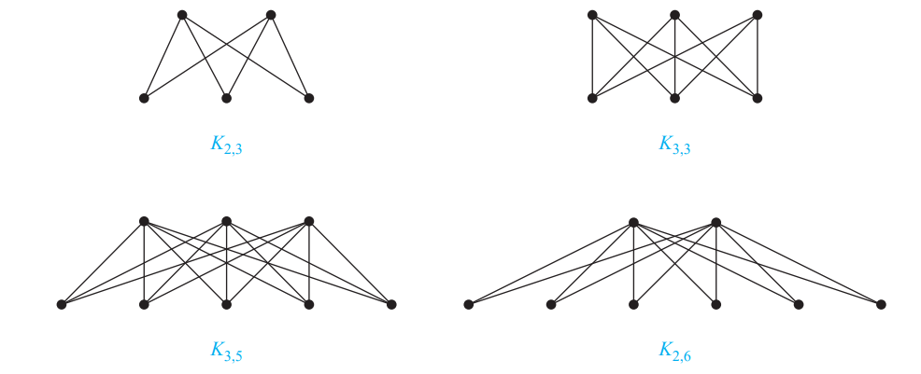
Continued…
7. Complete Bipartite Graph (Kn,m)
A complete bipartite graph Km,n is a graph that has its vertex set partitioned into two subsets of m and n vertices, respectively with an edge between two vertices if and only if one vertex is in the first subset and the other vertex is in the second subset. The complete bipartite graphs K2,3, K3,3, K3,5, and K2,6 are displayed in Figure below

Slide 10
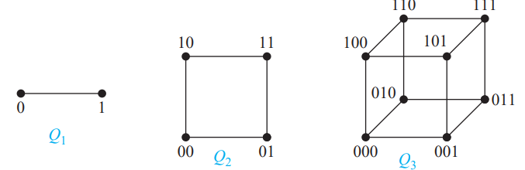
Continued…
8. n-Cubes:-
An n-dimensional hypercube, or n-cube, denoted by Qn, is a graph that has vertices representing the bit strings of length n. Two vertices are adjacent if and only if the bit strings that they represent differ in exactly one bit position. We display Q1, Q2, and Q3 in Figure below

Slide 11
Graph Terminology
Adjacency:-Two vertices u and v in an undirected graph G are called adjacent (or neighbors) in G if u and v are endpoints of an edge e of G. Such an edge e is called incident with the vertices u and v and e is said to connect u and v.
Degree:- The degree of a vertex in an undirected graph is the number of edges incident with it, except that a loop at a vertex contributes twice to the degree of that vertex. The degree of the vertex v is denoted by deg(v).
degree of a vertex: number of edges connected (indegree, outdegree)

Slide 12
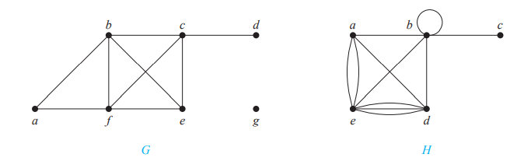
Continued…
Find the degrees of each vertex in the following graph G and H.

Slide 13
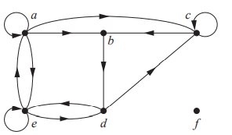
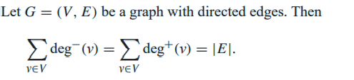
Continued…
An undirected graph has an even number of vertices of odd degree.
In a graph with directed edges the in-degree of a vertex v, denoted by
deg−(v) = is the number of edges with v as their terminal vertex.
The out-degree of v, denoted by
deg+(v) = is the number of edges with v as their initial vertex.
Note that :A loop at a vertex contributes 1 to both the in-degree and the out-degree of this vertex.)
Example:- Find the in-degree and out-degree of each vertex in the graph G with directed edges shown in Figure below.

Slide 14
Continued…
3. Subgraphs
a
a
e
a
b
e
b
e
b
d
d
c
c
d
d
induced subgraph
include all edges
of E in V₁
c
c
spanning subgraph
V₁=V

Slide 15
Continued…
4. Complements
Def. complement of a graph or The complementary graph G of a simple graph G
has the same vertices as G.
Two vertices are adjacent in G if and only if they are not adjacent in G..
a
G G
a
e
e
b
b
d
d
c
c

Slide 16
5.3. Graph Isomorphism
Graph Isomorphism
a
b
1
2
c
w x y z
3
4
d

Slide 17
Continued…
Determine the following graphs in the examples are Isomorphism are isomorphic or not
Example 1
q
r
a
w
j
f
e
b
v
y
z
x
i
g
h
t
d
c
u
a-q c-u e-r g-x i-z b-v d-y f-w h-t j-s, isomorphic
Example 2
degree 2
vertices=3
degree 2 vertices=2
Can you think of an algorithm for testing isomorphism?

Slide 18
5.4. Matrix Representation of a Graph
Adjacency Matrix

Slide 19
Adjacency Matrix
A simple graph G = (V, E) with n vertices
can be represented by its adjacency matrix,
A, where entry a_{ij} in row i and column j is
1 if { v_{i}, v_{j} } is an edge in G,
a_{ij} =
0 otherwise.

Slide 20
Finding the adjacency matrix
c
c
This graph has 6 vertices a, b, c, d, e, f. We can arrange them in that order.
b
d
f
a
a
e
e
W₅

Slide 21
Finding the adjacency matrix
TO
a b c d e f
c
c
FROM
a 0 1 0 0 1 1
b
c
d
e
f
b
d
f
a
a
e
e
W₅
There are edges from a to b, from a to e, and from a to f

Slide 22
Finding the adjacency matrix
TO
a b c d e f
c
c
FROM
a 0 1 0 0 1 1
b 1 0 1 0 0 1
c
d
e
f
b
d
f
a
a
e
e
W₅
There are edges from b to a, from b to c, and from b to f

Slide 23
Finding the adjacency matrix
TO
a b c d e f
c
c
FROM
a 0 1 0 0 1 1
b 1 0 1 0 0 1
c 0 1 0 1 0 1
d
e
f
b
d
f
a
a
e
e
W₅
There are edges from c to b, from c to d, and from c to f

Slide 24
Finding the adjacency matrix
TO
a b c d e f
c
c
FROM
a 0 1 0 0 1 1
b 1 0 1 0 0 1
c 0 1 0 1 0 1
d
e
f
b
d
f
a
a
e
e
W₅
COMPLETE THE ADJACENCY MATRIX . . .

Slide 25
Finding the adjacency matrix
TO
a b c d e f
c
c
FROM
a 0 1 0 0 1 1
b 1 0 1 0 0 1
c 0 1 0 1 0 1
d 0 0 1 0 1 1
e 1 0 0 1 0 1
f 1 1 1 1 1 0
b
d
f
a
a
e
e
W₅
Notice that this matrix is symmetric. That is a_{ij} = a_{ji} Why?

Slide 26
An Adjacency Matrix
a
b
a b c d e
a
0 1 0 0 1
b
1 0 1 0 1
c
c
0 1 2 0 1
d
0 0 0 0 1
d
e
e
1 1 1 1 0
Graph
Adjacency Matrix

Slide 27
5.5. Path and Connectivity of a Graph
a
x
y
e
path: no vertex can be repeated
a-b-c-d-e
trail: no edge can be repeat
a-b-c-d-e-b-d
walk: no restriction
a-b-d-a-b-c
b
d
c
length: number of edges in
this (path,trail,walk)
closed if x=y
closed trail: circuit (a-b-c-d-b-e-d-a,
one draw without lifting pen)
closed path: cycle (a-b-c-d-a)

Slide 28
Continued…
Definition:- Let G=(V,E) be an undirected graph.
We call G connected
if there is a path between any two distinct vertices of G.
a
e
a
e
b
disconnected with
two components
b
d
d
c
c
Disconnected graph
Connected graph

Slide 29
Continued…
multigraph of multiplicity 3
multigraphs

Slide 30
5.6. Eulerian and Hamiltonian Graphs

Slide 31
1. Eulerian Graphs
Euler Trails and Circuits
Corollary: The number of vertices of odd degree must be even.
Def. Let G=(V,E) be an undirected graph or multigraph with no isolated vertices.
Then G is said to have an Euler circuit if there is a circuit in G that traverses every edge of the graph exactly once.
If there is an open trail from a to b in G and this trail traverses each edge in G exactly once, the trail is called an Euler trail.
Theorem:- Let G=(V,E) be an undirected graph or multigraph with no isolated vertices.
Then G has an Euler circuit if and only if
G is connected and every vertex in G has even degree.
a
All degrees are odd. Hence no Euler circuit
for the Konigsberg bridges problem.
b
d
c

Slide 32
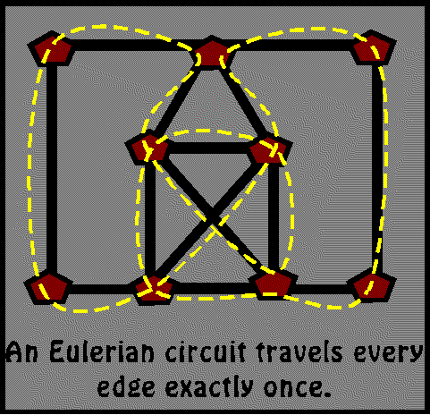
Continued…
A Euler Trails is a snowplow problem where a snow plow needs to plow every street once.
Start and finish
Euler circuits is a Trails that ends at the same vertex it started
# of ODD Vertices | Implication (for a connected graph)
0 | There is at least one Euler Circuit.
1 | THIS IS IMPOSSIBLE! Can’t be drawn
2 | There is no Euler Circuit but at least 1 Euler Trails.
more than 2 | There are no Euler Circuits or Euler Trails.

Slide 33
2. Hamilton Graphs
Hamilton Paths and Cycles
a path or cycle that contain every vertex
Unlike Euler circuit, there is no known
necessary and sufficient condition for a
graph to be Hamiltonian.
Ex.
a
b
c
There is a Hamilton path, but no
Hamilton cycle.
d
e
f
g
h
i

Slide 34
Hamilton Paths and Cycles
Example
x
start labeling from here
4x's and 6y's, since x and y must
interleave in a Hamilton path (or cycle),
the graph is not Hamiltonian
y
y
y
x
y
y
x
x
y
The method works only for bipartite graphs.
The Hamilton path problem is still NP-complete when restricted
to bipartite graphs.

Slide 35
5.7 Trees and Forest
A tree is a connected simple undirected graph with no simple circuits.
Properties:
There is a unique simple path between any 2 of its vertices.
No loops.
No multiple edges.

Slide 36
Example 1
●a
●b
c ●
● d
e ●
● f
G1 : This graph is a Tree because it is a connected
graph with no simple circuits

Slide 37
Example 2
a
b
d
c
e
f
G2: is not a tree “ because there is a cycle a, b, e, d, a”

Slide 38
Example 3
b
G3: is not a tree “because it’s not connected”. In this case it’s called forest in which each connected component is a tree.
Component 1: a, f
Component 2: c, e, b, d
a
c
d
e
f

Slide 39
Forest
An undirected graph without simple circuits is called a forest.
You can think of it as a set of trees having disjoint sets of nodes.

Slide 40
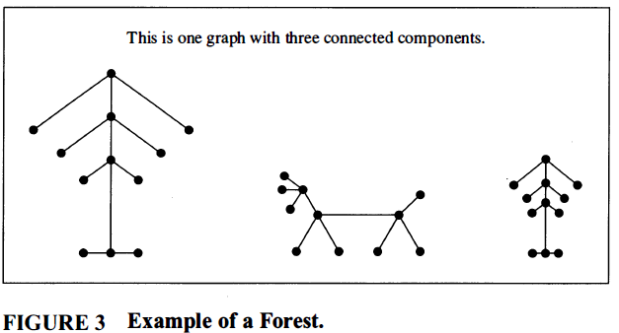

Slide 41
Rooted (Directed) Trees
A rooted tree is a tree in which one node has been designated the root and every edge is directed away from the root.
A binary tree is a rooted tree if every internal vertex has at most two children
A full binary tree is a rooted tree if every internal vertex has exactly two children

Slide 42
Definitions
[Node a is the root]
Root: Vertex with in-degree 0
a
b
c
d
f
g
e
y

Slide 43
Example
a
b
c
d
e
f
g
Binary tree
Full binary tree

Slide 44
5.8. Planar Graphs
Def. A graph (or multigraph) G is called planar if G can be drawn in the plane with its edges intersecting only at vertices of G. Such a drawing of G is called an embedding of G in the plane.
Example: K₁,K₂,K₃,K₄ are planar, K_{n} for n>4 are nonplanar.
K₄
K₅
applications: VLSI routing, plumbing,...

Slide 45
Continued…
Def. Bipartite graph and complete bipartite graphs (K_{m,n})
K_{4,4}
K_{3,3} is not planar.
Therefore, any graph containing K₅
or K_{4,4} is nonplanar.

Slide 46
Continued…
Planar Graphs
A planar graph divides the plane
into several regions (faces), one
of them is the infinite region.
R1
K₄
R4
R2
v=4,e=6,r=4, v-e+r=2
R3
Theorem (Euler's planar graph theorem)
For a connected planar graph or multigraph:
v-e+r=2
number
of vertices
number
of regions
number
of edges

Slide 47
5.9. Graph Coloring
Def. If G=(V,E) is an undirected graph, a proper coloring of G occurs when we color
the vertices of G so that if ab is an edge in G, then a and b are colored with
different colors.
The minimum number of colors needed to properly color G is called
the chromatic number of G and is written χ(G).
a
3 colors are needed.
a: Red
b: Green
c: Red
d: Blue
e: Red
e
χ(K_{n})=n
b
χ(bipartite graph)=2
d
c

Slide 48
End of Chapter 5 Thank You

